Slide 1
Copyright & Licensing

Slide 2
Presentation Outline
Copyright Law
Software and copyright
Licensing
Software Piracy
Copyright and the Internet
<number>/18

Slide 3
What is Copyright?
In pairs discuss what you think this covers and in your own words write down a definition for copyright
<number>/18

Slide 4
Definition of Copyright
Copyright gives the creators of certain kinds of material rights to control ways their material can be used. These rights start as soon as the material is recorded in writing or in any other way.
<number>/18

Slide 5
Group Task
What data/information may be held in organisations that may need protecting?
<number>/18

Slide 6
What data/information may be held in organisations that may need protecting?
Logo/identity
Brand image
Product information
Designs
Schedule of work
QIP Procedures
<number>/18

Slide 7
Copyright Law
Copyright gives certain legal protection to authors of materials
Originally intended for books, sheet music, photographs etc.
In the U.K. is covered by the Copyright, Designs and Patents Act 1998
This is the U.K. form of the Intellectual Property Rights (IRP) legislation which exist in most countries
<number>/18

Slide 8
Copyright Law 2
The legislation exists to both
  ensure people are rewarded for the endeavours
  give protection to the copyright holder if there is an infringement
Copyright activities - buying and selling of rights; legal cases against offenders is big business cost many £ millions each year
<number>/18

Slide 9
Copyright Law 3
Current legislation embodies
Moral Rights - copyright holder has a right to ensure works are not used in an inappropriate way
‘fair use’ clauses - e.g. schools allowed to copy 1% of a published work
<number>/18

Slide 10
What’s covered ?

Slide 11
What’s covered
Literary works - includes books, poetry, telephone directories, computer programs
Musical works - of all kinds
Dramatic works - not only plays but adverts etc.
Artistic works - including crafts e.g. jewellery designs
<number>/18

Slide 12
What’s covered 2
Sound recordings - discs, tapes, CDs etc.
Film recordings - on all media
Broadcasts - both audio and video
Cable broadcasts - e.g. cable TV programmes
Typographical arrangements - e.g. e-books, web pages (of text) etc.
<number>/18

Slide 13
File Sharing
http://news.bbc.co.uk/1/hi/technology/7486743.stm
http://news.bbc.co.uk/1/hi/technology/7488577.stm
<number>/18

Slide 14
File Sharing
Who is in the right?
Virgin Media or the File Sharers
<number>/18

Slide 15
Problems
  Multimedia not specifically covered
  Computer graphics cause particular problems.
  Local copyright laws take precedence - important in Internet disputes
  ‘Look and feel’ - difficult to prove that software is a copy
  ‘Reverse engineering’ - write a computer program so that it looks the same but uses different code
<number>/18

Slide 16
Internet Specific Problems
Copying of pictures, sound files, music is rife esp. Fan sites
Many believe, mistakenly, that internet is copyright free.
Site ‘cloning’ becoming widespread
Only large companies have resources to pursue claims e.g. Disney
<number>/18

Slide 17
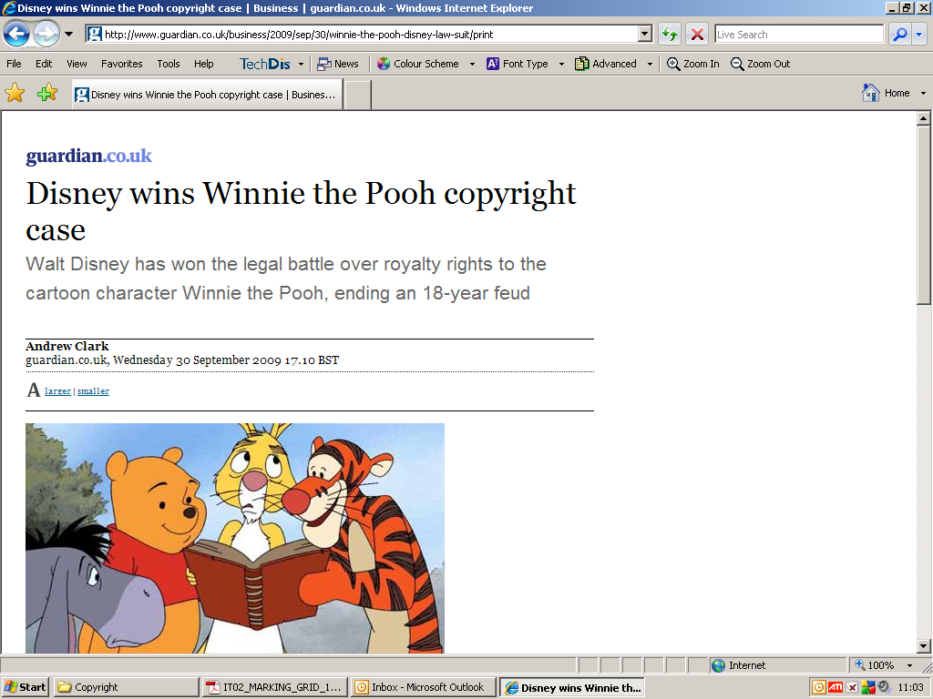
Disney Case

Slide 18
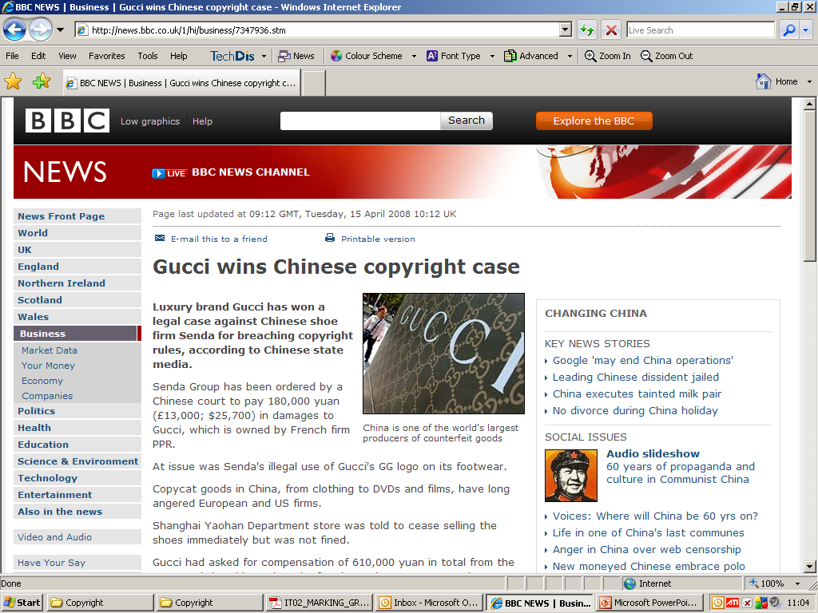

Slide 19
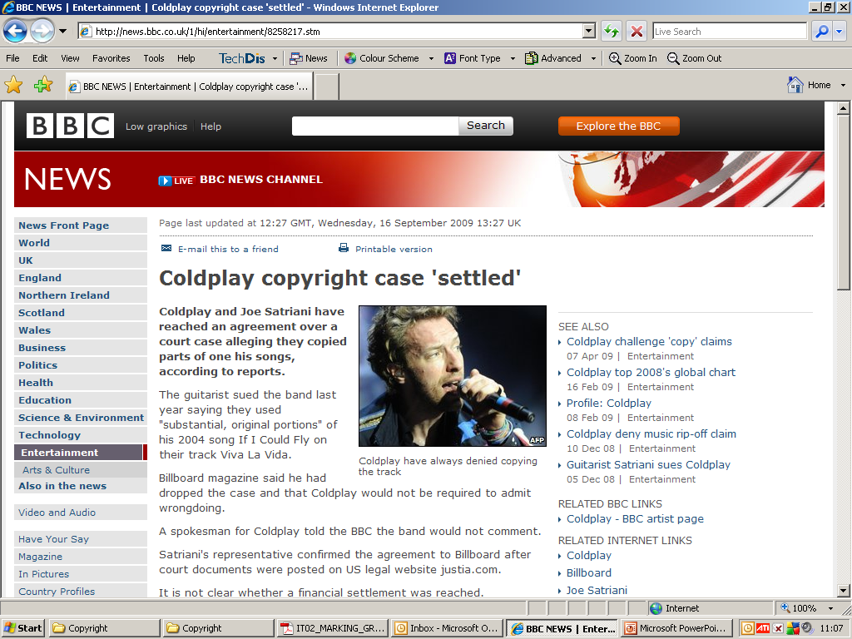
In court papers filed in Los Angeles, Cold play also claimed Mr Satriani's song "lacks originality" and should not receive copyright protection.

Slide 20
Software Licensing

Slide 21
Basic licence
When you purchase software you only get a ‘licence to use’
Shrink wrap licence use - opening the packet means that you agree
Standard licence allows you to put a single copy on one computer
Some allow one other copy for back up
<number>/18

Slide 22
Other common licences
Multi user licence - can be used by a set number of people
Site licence - can be used on all computers on one site e.g. a school
Academic licence - for students and teachers, usually single user
Education licence - for schools, colleges; cheap, multi user
<number>/18

Slide 23
Other systems
Shareware - have to pay for updates, support, usually time limited as they want you to purchase the full version
Freeware - no cost at all (You don't own the copyright)
Free software movement - encourages freeware authors
<number>/18

Slide 24
Piracy
Essentially the copying of software without an appropriate licence
In UK and USA video games (on CD) very popular
CD-R and Internet has made process very easy
<number>/18

Slide 25
Copy protection
At basic level
  Serial no.
  legal protection (copyright act)
More advanced
  Dongles (bits of hardware used for expensive pieces of software)
  Electronic copy protection - code scrambler
  Regionalisation e.g DVD (this country set to 2)
<number>/18

Slide 26
Problems
Systems do not work
  Copyright act - legal mine field
  Serial No. - web site specialise in publishing serial No.s for popular software
  Dongles - reverse engineering of device
  Electronic methods - broken within hours of publication
  Regionalisation - code breakers widely available
<number>/18

Slide 27
Conclusions
Software piracy will remain major problem
Internet and CD-R exacerbate problem
Piracy keeps software prices high
Encourages more piracy - catch 22
Music, video and game copying increasingly common, will increase with advent of DVD-R
<number>/18

Slide 28
The End

